Slide 1
Federal Advocacy | Overview
Fall 2023
KARA HAAS
Federal Relations
September 21, 2023

Slide 2
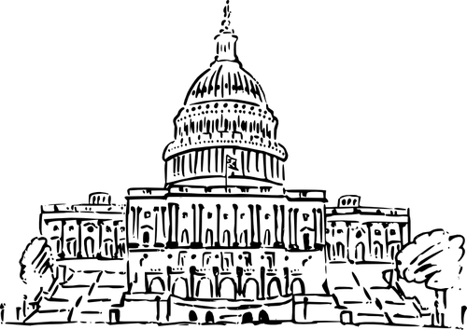
118th Congress
CONGRESSIONAL PRIORITIES
Avoid Government Shutdown/Complete FY24 process
NDAA
Expiring Reauthorizations
FAA, Farm Bill, Pandemic, Health
Build Record - AI, Quantum, Data Privacy, Tax
Impeachment Inquiry (House only)

Slide 3
FY24 Appropriations
FUNDING CHALLENGES
None of 12 bills completed
House Republicans $119 billion BELOW FY23
NIH -$4.3 b; ARPA-H -$1 b
NSF, DOE, NIST - below CHIPS
Emergency Funding Ukraine/FEMA
POLICY RIDERS
Reproductive health, Trans rights, DEI, Climate, Title X, Fetal Tissue, Open Access, Reestablish China Initiative
OUTLOOK
Shutdown ??
Level or inflationary increase
FY25 - R&D Prioritized; Adhere to FRA (+1 percent)

Slide 4
Research Compliance/Security - Congress
NDAA
Outbound Investment (Executive Order/Advanced Notice of Proposed Rulemaking) BIPARTISAN
Banks/Section 214 - public disclosure of “researcher” information
Modifications to DOD Security Requirements
Burchett/Section 809 - not less than 25 percent cost sharing
Negotiations expected to continue thru Tgiving, at least.
8

Slide 5
Timeline of Key Security Actions
China Initiative Begins NSF/NIH DCL NSPM33 Release Affirmation of NSPM33
(Nov 2018) (Ju 2018) (Ja 2021) (Aug 2021)
China Initiative Ends NSPM33 Implementation Operationalization NSPM33
(Feb 2022) (Ja - Aug 2022) (Mar 2023 - current)
Legislatively - NDAA (FY19 - 23), CHIPS & Science Act (August 2022)

Slide 6
NSPM33/CHIPS - Implementation Updates
NSPM33
Common Disclosure Form - Ja 2024?
Research Security Program - OMB August - Ja 2024
(foreign travel, cybersecurity, training - research security and export control)
Agencies directed to incorporate risk based measures- Ongoing
E.g DOD - July Policy/Decision Matrix - Effective now, updated at least annually
CHIPS
Research Security Training Modules - completed 2024
SECURE - May 2024 award
$50k Disclosure (NSF only) - data collection in draft PAPPG for 2024 implementation

Slide 7
 | FY2023 | FY24 House Committee | FY24 House v 23 | FY24 Senate Committee | FY24 Senate v 23
NIH | 47459 | 45100 | -7.8% | 47812 | 0.7%
ARPA-H | 1500 | 500 | -66.7% | 1500 | 0.0%
NSF | 9874 | 9630 | -2.5% | 9500 | -3.8%
DOD Basic Research | 2920 | 2526 | -13.5% | 3224 | 10.4%
DARPA | 4060 | 4123 | 1.6% | 4092.6 | 0.8%
DOE Science | 8100 | 8100 | 0.0% | 8430 | 4.1%
ARPA-E | 470 | 470 | 0.0% | 450.0 | -4.3%
EPA S&T | 802 | 560 | -30% | 795 | -0.9%

