Slide 1
Office of the Vice Provost for Research (OVPR)
Research Management Meeting
September 21, 2023
Mission: The OVPR strives to encourage, cultivate, and coordinate research & scholarship across Harvard, promoting academic collaboration among its schools, affiliated institutions, and inter-faculty initiatives (Centers, Institutes).

Slide 2
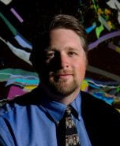
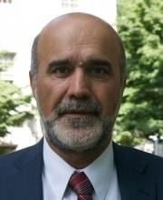
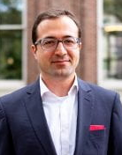
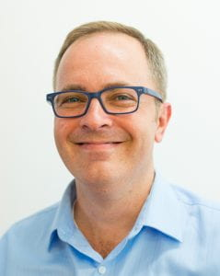
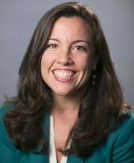
OVPR Portfolio of Activities
University strategic priorities
Research policies & compliance
Research data security
John H. Shaw
Vice Provost for Research
Ara Tahmassian
Chief Research
Compliance Officer
Emre Keskin
University Research
Data Officer
Interfaculty initiatives
Research funding
Willy Lensch
Associate Provost
for Research
Brooke Pulitzer
Snr. Assistant Provost
for Research
Engages with Office for Sponsored Programs (OSP), Office of Technology Development (OTD), Alumni Affairs & Development (AAD), Office of General Counsel other Vice Provost functions

Slide 3
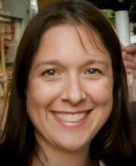
Research Development Team
Brooke Pulitzer
Snr. Assistant Provost
for Research
Liza Harsch
Program Manager
for Research Development
Autumn Bennett
Program Coordinator
for Research Development
Select OPP internal funding opportunities
William F. Milton Fund
Lemann Brazil Research Fund
Aramont Fund for Emerging Science Research
Motsepe Presidential Research Accelerator Fund for Africa
Climate Change Solutions Fund (2014-21)
External Limited Submission Opportunities (LSOs)
Sponsor limits application for a grant/fellowship by instructing universities to nominate only one or a small number of candidates
Eligibility and nomination rules of programs vary widely
OVPR manages the internal competition

Slide 4
LSOs – At a Glance
Overarching goal is to support faculty research, including securing funding, when central/institutional coordination is necessary and/or helpful
OVPR assumes active role in over 100 LSOs per year, working closely with OSP, school and department administrators, and faculty
OVPR fully manages over 40 Harvard competitions/year
Includes federal funding (e.g., NSF, DOE, NEH) agencies and private sponsors (e.g., Mellon, Carnegie, Blavatnik, Packard)
Some opportunities are anticipated (annual); some are surprises

Slide 5
LSO Process
OVPR notified of opportunity*
OVPR application process*
OVPR review process
OSP/ORA review*
Submission to sponsor*
Ideal timelines
≥ 4 weeks
≥ 2 weeks
≥ 10 days
≥ 4 weeks

Slide 6
Harvard University Funding Portal (HUFP)

Slide 7
LSO: Range
Straightforward: Packard
Standard annual timeline
Complex: DOE/NSF
Inconsistent eligibility and terms
Consistent eligibility
Straightforward application
Harvard success = understanding of priorities
Very short timelines
Complex applications

Slide 8
LSO: Challenges and Opportunities
Nuances in eligibility (UEI numbers; tenure-track discrepancies, etc.) and changes in terms (IP, etc.) = close reading and sponsor back-and-forth
Coordinating differing school-specific processes and communication streams; ensuring appropriate dissemination
Large-scale collaborative proposals, with relatively short timelines
Clarity around nominator roles and redundancies, and on institutional endorsement signatory/attestation process
International/politically-sensitive funding sources

Slide 9
Thank you

